Slide 1
FPGA PROJECT REPORT
Problem Statement: Design a Wiener Filter for image processing. Use VGA and HDL or HLS for implementation.
(Due to unavailability of VGA cable, it was implemented using UART protocol).
Github Repositary Link: https://github.com/ArismitaM/Weiner-Filter-using-FPGA
Team Members:
  Arismita Mukherjee IMT2023585
  Taral Sanka IMT2023588

Slide 2
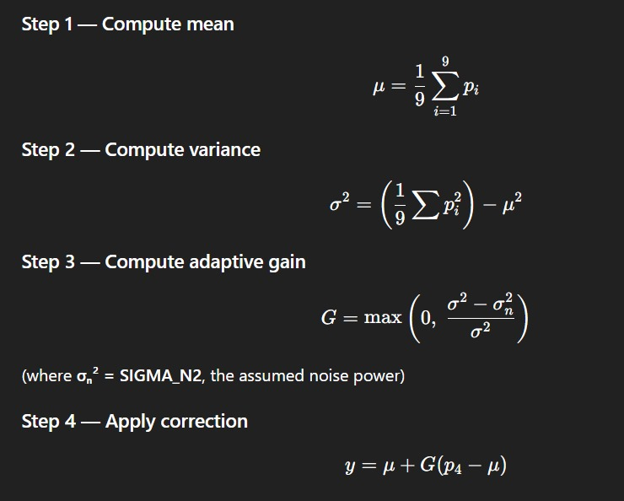
Wiener Filter:
A Wiener Filter is a statistical signal processing filter that minimizes the mean square error between an original, noiseless signal and an estimated signal, effectively removing noise and restoring degraded images
It minimizes the mean square error (MSE) between the original and estimated signals.

Slide 3
Principle of Wiener Filter:
If variance is small (flat region, mostly noise):
→ G becomes small → output ≈ mean (strong smoothing)
If variance is large (edges / details):
→ G becomes large → output ≈ center pixel (preserves edges)
We used:
CLK_FREQ = 25,000,000 (25 MHz pixel clock)
BAUD_RATE = 115200
we have chosen the above parameters
Bit duration (in s) = 1 / Baud Rate = 1/115200 = 8.68us
Clock cycles per bit = FPGA clf freq / baud rate = 217
Uart bit rate:
1 start + 8 data + 1 stop = 10 bits

Slide 4
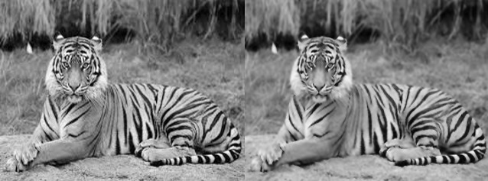
Image Filtering using Wiener Filter in Python
Before
Vs
After

Slide 5
MSE (Mean Squared Error) and PSNR (Peak Signal-to-Noise Ratio) are metrics used to quantify the difference between an original and a processed image, often used to evaluate image compression or noise reduction quality.
MSE measures the cumulative squared error between pixels, with a lower value indicating better quality .
PSNR represents the peak error relative to the maximum possible pixel value, with a higher value indicating better quality.
Original vs Wiener Filter Comparison For python:
MSE : 46.383
PSNR : 31.467 dB

Slide 6
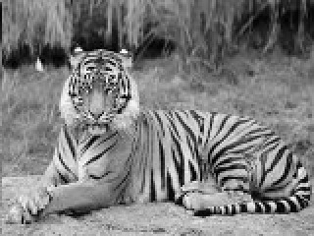

Image Processing using Wiener Filter in FPGA
Original Image Before Filtering
Image after Filtering in FPGA
Image Comparison Results In FPGA:
MSE : 0.713
PSNR : 49.600 dB

Slide 7
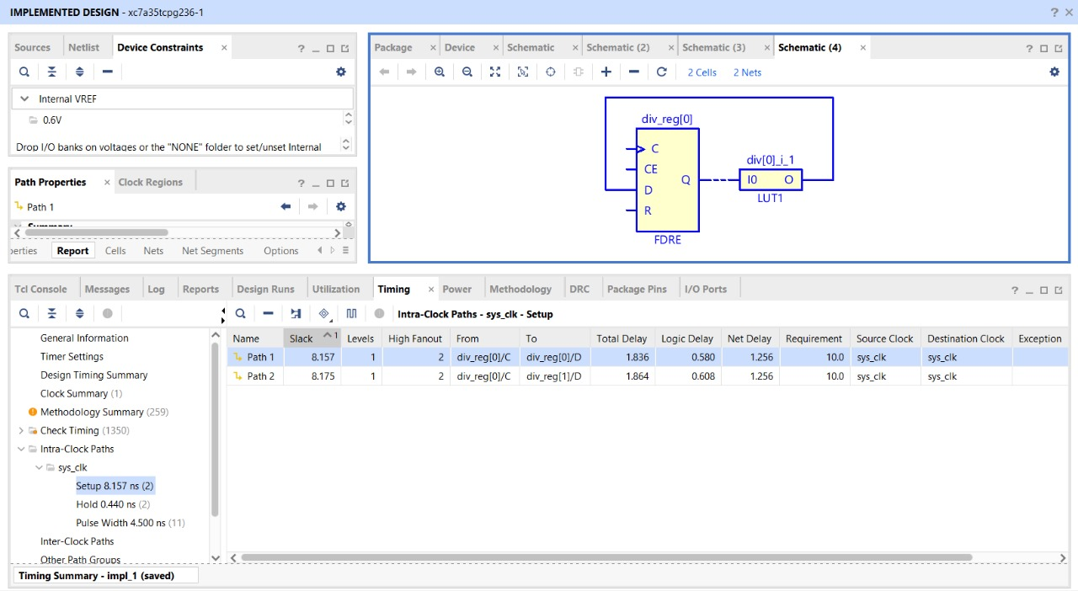
Timing Report With Critical Path:

Slide 8
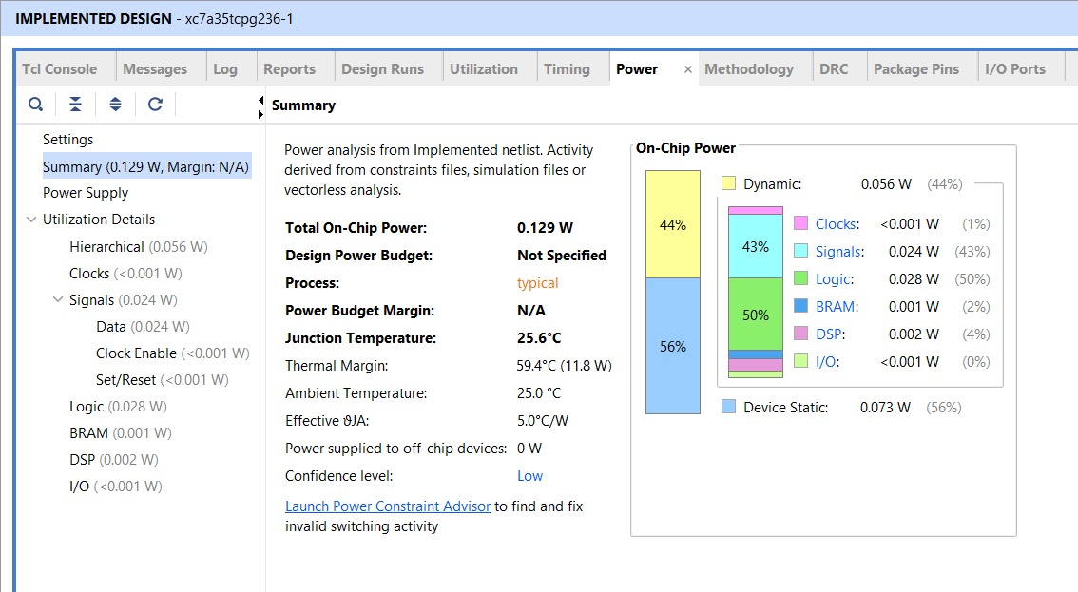
Power Report:

Slide 9
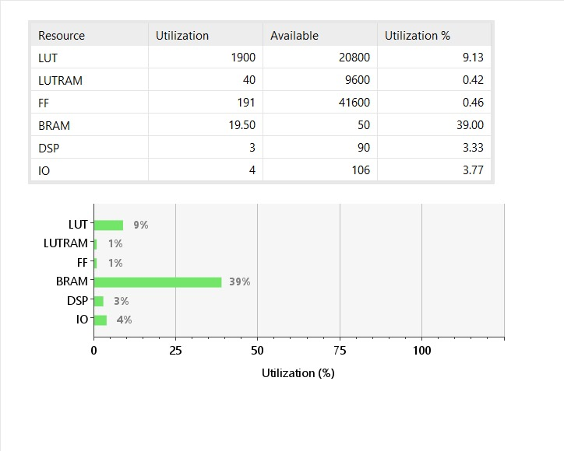
Utilization Summary:

Slide 10
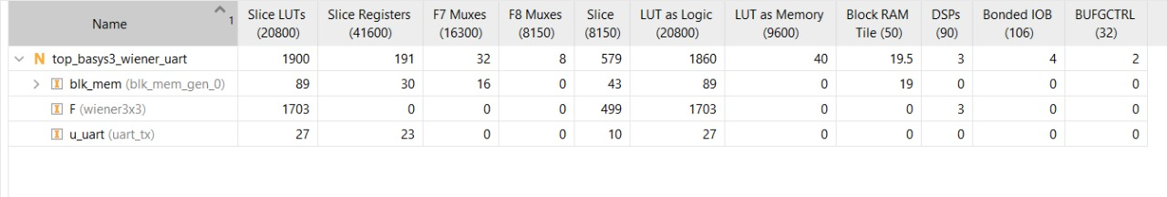
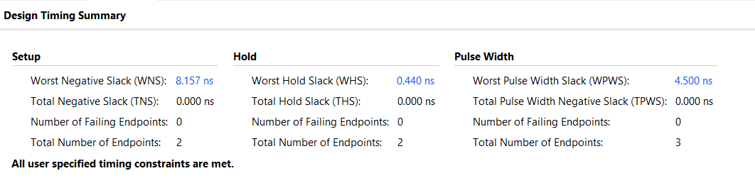
Utilization Hierarchy:
Timing Summary:

Slide 11
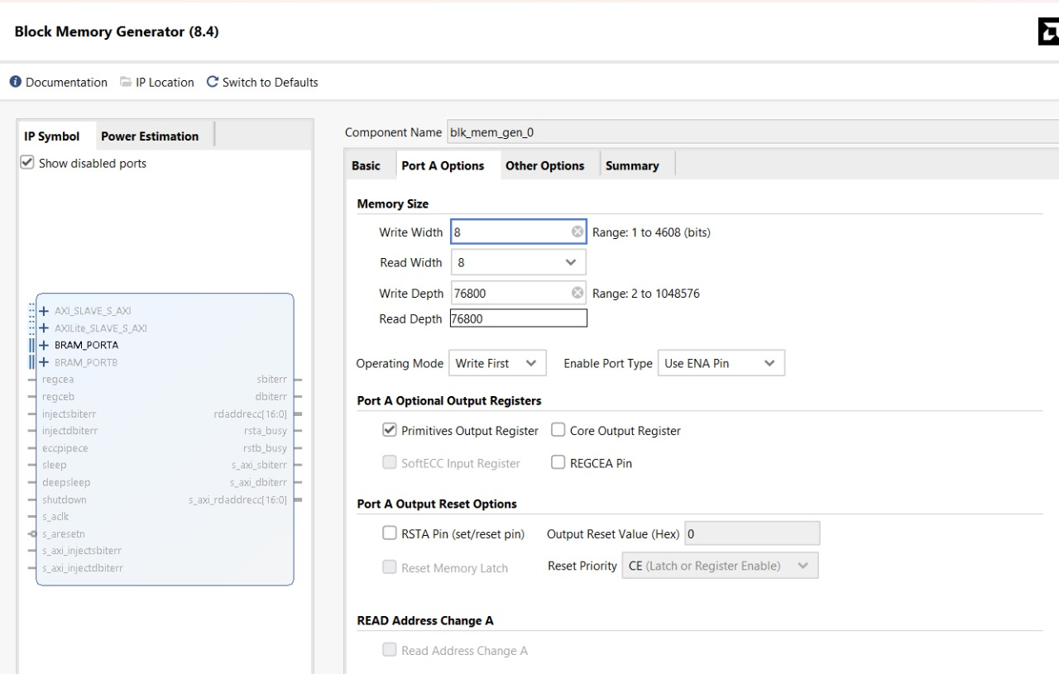
BRAM IP Configuration
Original Image-320x240 pixels = 76800

